Slide 1
Data and computational challenges for EGOV Luís Soares Barbosa
Embracing Geo-Spatial Data and Computational Methods for E-governance
UNU-EGOV - CSIS Tokyo University
17 November 2020

Slide 2
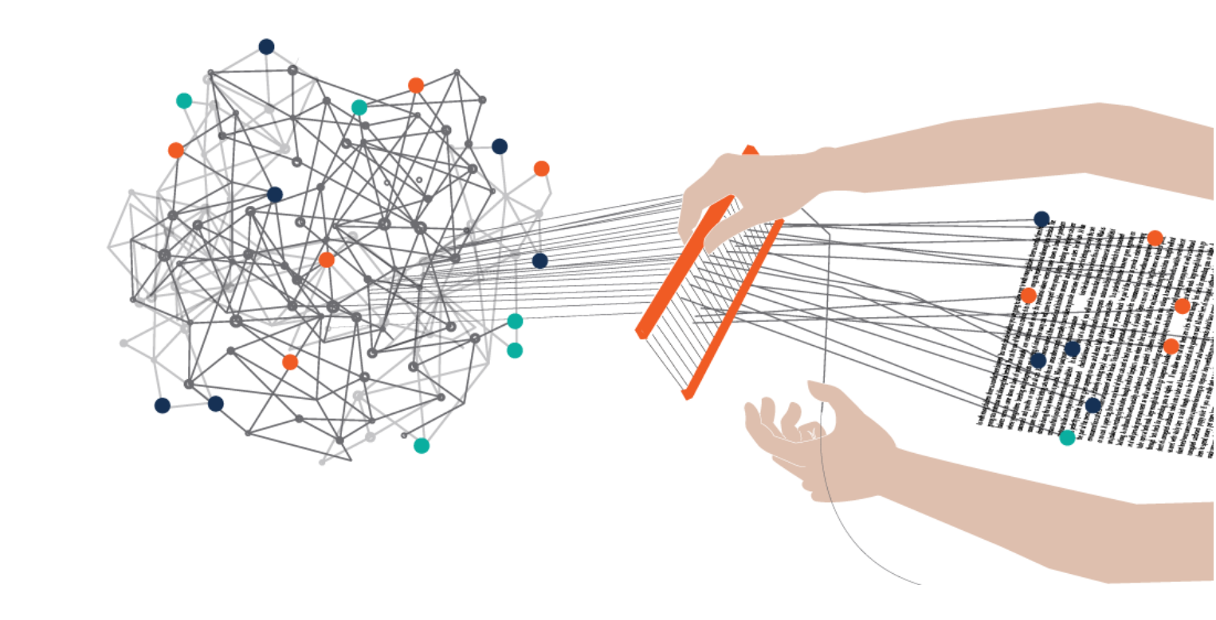
CHALLENGES
THE RAISE OF EVERYWARE
The answer is yes, but would you mind to repeat the question?
(Woody Allen)
Integration of digital, physical and biological systems through a global cyberspace and distributed, plastic information infrastructures which became the new public arena.
Notes:
… our devices are increasingly part of our personal ecosystem … – the ease with which users change its shape, content and form.

Slide 3
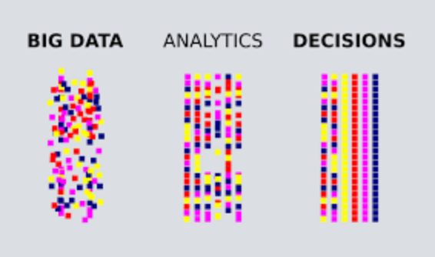
CHALLENGES
DATA AS AN ASSET
… and however
An unprecedent resource
Face detection and recognition
(when you want to be forgoten?)
Alerts for risks of your driving style
(to be handled to your insurance company?)
Predicting the risks of re-offending of criminals
(just when you’ve served your sentence?)
Notes:
Data as a raw (artificial) resource
Data as an asset is transforming Economy, Social interaction, Personal and social perception, Citizenship, Governance

Slide 4

DATA AND THE RAISE OF EVERYWARE
Contact tracing (not tracking) App
A step ahead of the vírus
Potential vs purpose
Privacy-by-design vs security risks
Local vs global data
Technology: trust vs marketing
Gov initiative vs private partnerships
Effectiveness vs consensus

Slide 5

RESEARCH CONCERNS FOR UNU-EGOV
Data at UNU-EGOV
Concerns and projects
Data governance
Open data and data-driven governance
Robust IT and data resilience
Certified algorithms
AI for digital governance
Data literacy

Slide 6
DATA GOVERNANCE
Aiming at lowering the cost of data management and creating value from data, has to handle several complex issues e.g.
Mismatch between data flow and logic and organization strucutre
Data fragmentation over many organizations and data policies
Diffused accountability, unknown data quality
Data platforms shaped by technical, organization and political factors, e.g. public vs private/social ownership; business model; interoperability; etc.
Organizations and their personnel defining, applying and monitoring the patterns of rules and authorities for directing the proper functioning of, and ensuring the accountability for, the entire life-cycle of data and algorithms within and across organizations.
Data governance: Organizing data for trustworthy AI
M.Janssen, P. Brous, E. Estevez, L. S. Barbosa, T. Janowski, GIQ, 37, 2020.
Notes:
(e.g. traditional trusted third parties (TTPs) that use certificates to provide non-repudiation services, are being replaced with distributed ledger or blockchain technology (DLT)

Slide 7

DATA-DRIVEN GOVERNANCE
Data-driven governance can
increase prediction ability
make public administrations more responsive
promote citizen participation
legitimize political decisions and add credibility to public institutions
restructure governance (and EGOV)
bridging between the

Slide 8
DATA-DRIVEN GOVERNANCE
Need for suitable regulatory frameworks
When data and essential public functions migrate to digital platforms, governments need to create the rules to maintain justice, fairness, safety and public interest.
Despite the growing global economy, data rights and data protection regulations are still heavily fragmented.

Slide 9
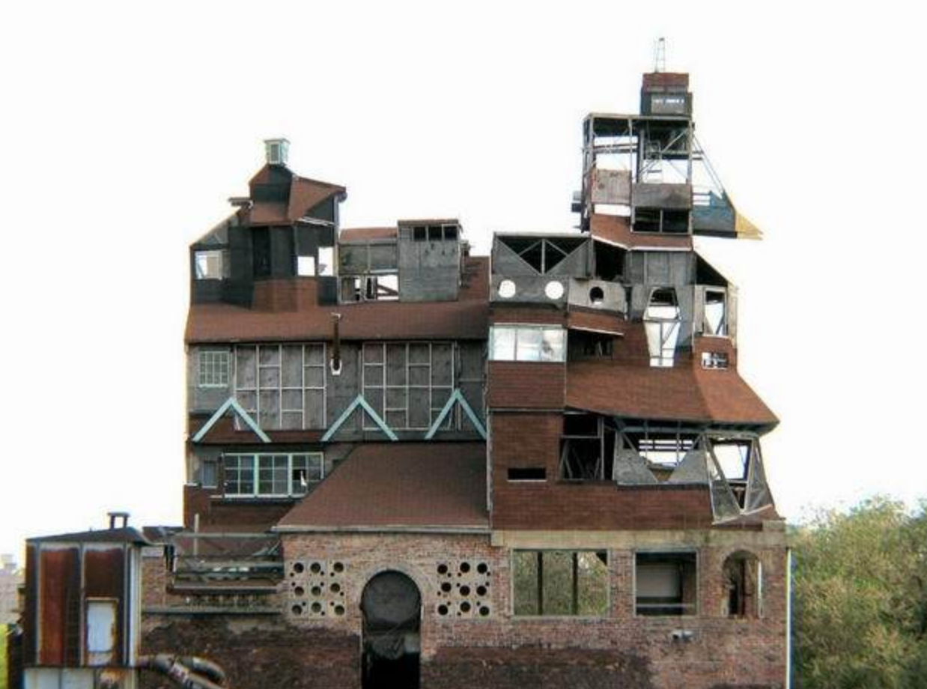
ROBUST IT INFRASTUCTURES AND DATA RESILIENCE
If builders built buildings the way programmers wrote programs, then the first woodpecker that came along would destroy civilization
(Gerald M. Weinberg)

Slide 10
CERTIFIED AI ALGORITHMS
Actually, for a part of ICT industry, correctness, i.e. strict conformance with the specification of the intended behaviour, and trustworthy development is not only emerging as a key concern, but simply becoming part of the business.
Open, explained vs certified algorithms
i.e. algorithms equipped with formal (automated) proofs of meeting critical,
specified constraints, e.g.
Behaviour
Security
Privacy
Conformance to purpose
Disabling features
cf current technologies to ensure privacy-by-design or proof-carrying code

Slide 11
A RESEARCH PROJECT: A Normative Reasoning Hub
Normative text are pervasive in modern societies.
Shortcomings, ambiguities, inconsistent multi-level reference, etc, have a direct social and economic impact and introduce administrative burden to governments and citizens.
Increased demand on acountability and citizen active participation in deliberation and decision processes (e.g. participatory budgets).
This entails the need for normative text to be analysed, re-structured and improved, becoming easy to read and accessible to everyone, independently of education background, and accessibility constraints.

Slide 12

A RESEARCH PROJECT: A Normative Reasoning Hub
AIMS
A Reasoning Hub for modelling, analysing, assessing, querying, and refactoring legal documents and regulations at two levels:
Micro-level, focused on the individual piece of normative text, aiming at extracting the relevant knowledge into a suitable logical framework
Macro-level, focused on the systematic analysis of corpora of normative text aiming at analysing normative patterns, their evolution over time, mutual dependence and interference

Slide 13
A RESEARCH PROJECT: A Normative Reasoning Hub
TECHNIQUES
A. Knowledge extraction
natural language processing at the micro level
reinforcement learning at the macro level
B. Formal semantic representation and processing through a suitable logical framework
C. Validation on new deontic logics enriched with
paraconsistent inference, to provide a form of reasoning resilient to the presence of inconsistencies
fuzzy inference to handle conflicting knowledge extracted from different sources.

Slide 14
A RESEARCH PROJECT: A Normative Reasoning Hub
... in order to generate
at the micro level, refactored text in a less ambiguous and more concise way
at the macro level, precise document analysis reports for pattern identification, trend analysis and temporal evolution

Slide 15
Thanks
L S Barbosa
barbosa@unu.edu

